Slide 1

Bangladesh Army University of Science and Technology, Saidpur Cantonment, Nilphamari Department of computer science and engineering
COURSE CODE: CSE 2206
Health management system
Presented by:
Ahnaf khan sadaf ( Id:220101026)
Mehedi Hasan (id:220101003)
Nubassim nushra (id:220101004)
Maisha Haque (id:220101008)
Presented to:
Hasan Muhammad kafi
Assistant professor
(DEPT. of cse)

Slide 2
outline
Introduction
Problem definition
Objectives
Related applications
Methodology
Tools and technologies
Conclusions
references
Page: 01

Slide 3

Introduction
Health management
Increased health deterioration
Giving basic consultation on health
Page: 02

Slide 4
Problem Definition
Society is now accustomed to diseases like blood pressure and diabetes, leading to widespread ignorance.
Lack of knowledge, effort, and resources prevents people from seeking regular check-ups.
The project aims to assist patients and their guardians in times of need.
The project targets situations where there are no nearby doctors or medical facilities available.
It seeks to address these issues to some extent and offer potential solutions.
Page: 03

Slide 5
Objectives
To help the patients in need of emergency medical advise
To reduce the possibility of normal illnesses like BP, diabetes, fever from getting extremely harmful for an individual
To reduce the chances of miscarriage of pregnant females who have bp, diabetes etc. and also to reduce the chances of complications during child birth
To create a healthy and better life
Page: 04

Slide 6
Related application
There are a few websites and apps such as:
Nih.gov[1]
healthline.com[2]
Soft Clinic[3]
Although these websites are meant to be for medical purposes. They don’t give all the necessary facilities.
Their main problem is that they are only made and concentrated for certain regions of the world. Some are only for research purposes which is not very helpful for non-medical personals.
Page: 05

Slide 7
methodology
Start
Enter disease, symptoms, age, weight and other informations
Calculates BMI and other aspects, then compares it to the stored data
Stored data on various diseases
Shows the result of analysis and comparison of data and the stage or state of the patient
End
Page: 06

Slide 8
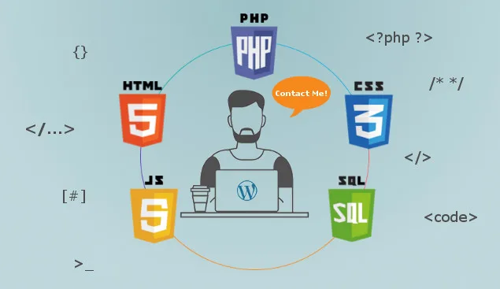
Tools and technologies
MySQL
Php
Css
Html
JAVASCRIPT
Page: 07

Slide 9
Conclusion
As the project is all about healthcare which will have information that will help the patient to understand his health condition based on his details.
This will help the patient to gain knowledge about his disease and take necessary steps to prevent it.
Page: 08

Slide 10
references
https://www.nih.gov/
https://www.healthline.com
https://www.techpout.com/hospital-management-software/#1_Soft_Clinic
Page: 09

Slide 11
THANK YOU
EVERYONE
Page: 10

